Slide 1
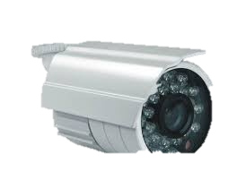


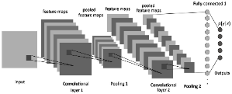

142 - Workflow improvements using Video Analytics Sunil Mandhan | Sagar P M
Problem Alerting the staff or scheduling service for patients who
Need assistance and immediate attention
Value Proposition Patients who are feeling weak and need assistance are to be benefited, increasing the care and satisfaction, and workflow improvements – prioritize outpatient interaction with doctor based on the severity
Technology
Video/Images
Convolutional Neural Network model
Posture
Retrained resnet50
Future Plan Prototype 1: Pose prediction
Prototype 2: Pose + Face expression
Final Stage: Pose + Face accuracy improvements
Facial expression
Need assistance | Normal
Staff
Scheduling Service
Deep learning based workflow improvement

